Slide 1
Perceptron

Slide 2
Introduction
Perceptrons
  invented by Frank Rosenblatt and Minsky- Papert
  The first learning neural network model by computation
  became the foundation of pattern recognition research
  They learn by weight adjustment

Slide 3
Units of Perceptron
Sensory unit ( input unit )
Associator unit (hidden unit)
Response unit ( output unit )
Sensory Unit
Associator Unit
Response Unit
The sensory and association units have binary activations and response unit has +1, 0 or -1 activation

Slide 4
Perceptron Types
Single layer Perceptron (SLP)
Multilayer Perceptron (MLP)

Slide 5
Single Layer Perceptron
● First neural network with the ability to learn
● Made up of only input neurons and output neurons
● Input neurons typically have two states: ON and OFF
● Output neurons use a simple threshold activation function
● In basic form, can only solve linear problems
► Limited applications

Slide 6
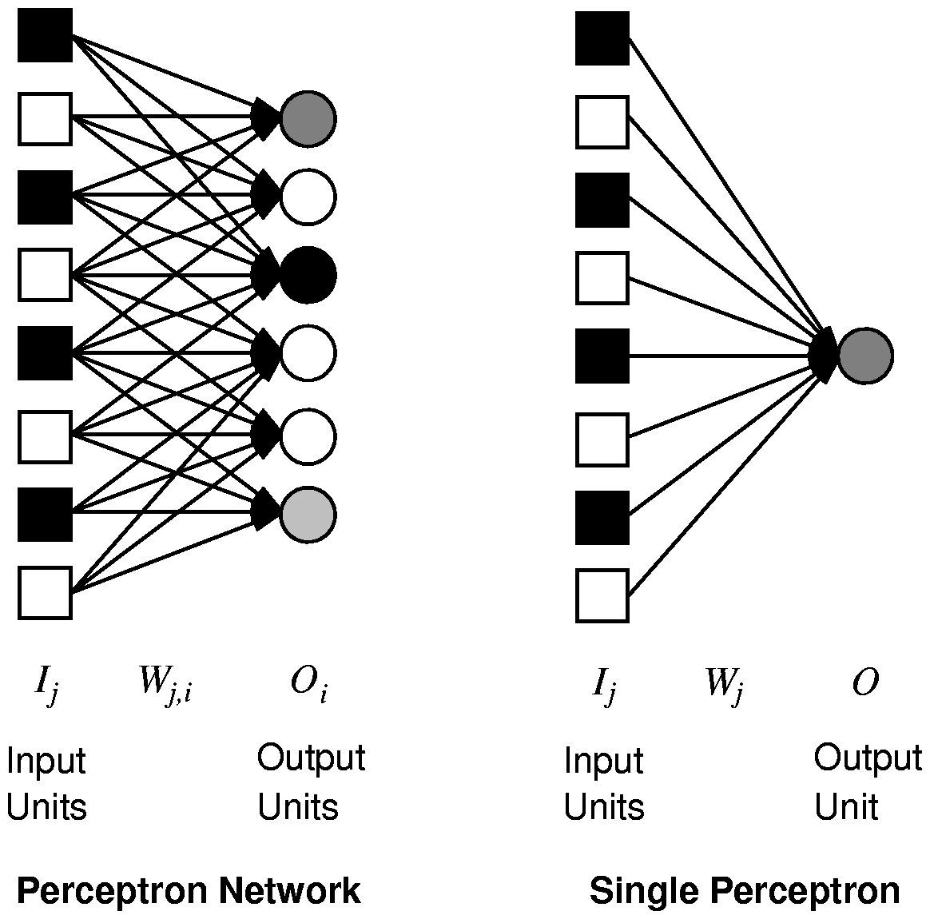
Single Layer Feed-forward Neural Networks
Perceptrons
Single-layer neural network (perceptron network)
A network with all the inputs connected directly to the outputs
  Output units all operate separately: no shared weights
Since each output unit is
independent of the others,
we can limit our study
to single output perceptrons.

Slide 7
(x0) bk
X1
Model of SLP
Wk0
WK1
X2
WK2
K
Vk
Σ
WK3
X3
WKn
Xn
V = b+Σ X_{i} W_{i}
_{j=1}
b (bias) is now treated as input 0 so
V = Σ Xi Wi
j=0

Slide 8
Single Layer Perceptron learning
The Perceptron learning algorithm can be stated as below.
1. Assign random values to the weight vector
2. Apply the weight update rule to every training example
3. Are all training examples correctly classified?
  a. Yes. Quit
  b. No. Go back to Step 2.
There are two popular weight update rules.
    i) The Perceptron rule, and
    ii) Delta rule

Slide 9
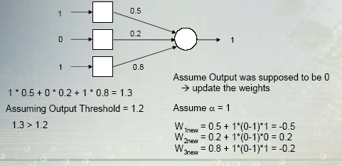
Perceptron Rule
● Uses supervised training
● If the output is not correct, the weights are adjusted according to the formula:
■ Wnew = Wold + α (desired – output)*input
α is the learning rate

Slide 10
Perceptron Training Algorithm
Repeat
for each training vector pair (x,t)
evaluate the output y when x is the input
if y≠t then
form a new weight vector W’ according
to W’=W + α ( t – y ) x
else
do nothing
end if
end for
Until y=t for all training vector pairs

Slide 11
Comments about the Perceptron training rule:
  • If the example is correctly classified the term (desired – output ) equals zero, and no update on the weight is necessary.
  • If the Perceptron outputs –1 and the real answer is 1, the weight is increased.
  • If the Perceptron outputs a 1 and the real answer is -1, the weight is decreased.
  • Provided the examples are linearly separable and a small value for α is used, the rule is proved to classify all training examples correctly (i.e, is consistent with the training data).

Slide 12
Testing Algorithm
Step 0 : The initial weights to be used here are taken from the training algorithms
Step 1 : For each input vector X to be classified, perform steps 2-3
Step 2 : Set activations of the input unit
Step 3 : Obtain the response of output unit
V_{in} = Σ Xi Wi
y = φ(Vin) = 1 if V_{in} > θ
0 if - θ <= V_{in} <= θ
-1 if Vin < - θ

Slide 13

Perceptron to Learn to Identify Digits
Digit | x₀ | x₁ | x₂ | x₃ | x₄ | x₅ | x₆
0 | 0 | 1 | 1 | 1 | 1 | 1 | 1
9 | 1 | 1 | 1 | 1 | 1 | 1 | 0
8 | 1 | 1 | 1 | 1 | 1 | 1 | 1
7 | 0 | 0 | 1 | 1 | 1 | 0 | 0
6 | 1 | 1 | 1 | 0 | 1 | 1 | 1
5 | 1 | 1 | 1 | 0 | 1 | 1 | 0
4 | 1 | 1 | 0 | 1 | 1 | 0 | 0
3 | 1 | 0 | 1 | 1 | 1 | 1 | 0
2 | 1 | 0 | 1 | 1 | 0 | 1 | 1
1 | 0 | 0 | 0 | 1 | 1 | 0 | 0
Seven line segments
are enough to produce
all 10 digits
2
1
3
0
6
4
5

Slide 14
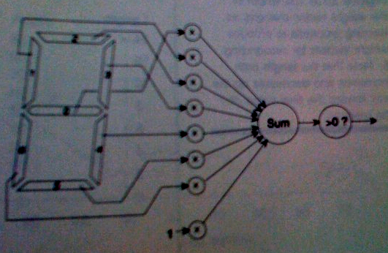
Perceptron to Learn to Identify Digits
Seven line segments
are enough to produce
all 10 digits
2
1
3
0
6
4
A vision system reports which of the seven segments
in the display are on, therefore producing the inputs
for the perceptron.
5

Slide 15
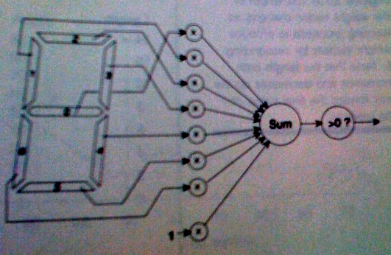
Perceptron to Learn to Identify Digit 0
2
Digit | x₀ | x₁ | x₂ | x₃ | x₄ | x₅ | x₆ | X₇ _{(fixed input)}
0 | 0 | 1 | 1 | 1 | 1 | 1 | 1 | 1
1
3
0
6
4
5
When the input digit is 0,
what’s the value of
sum?
-1
0
0
0
0
0
0
0
Sum>0 → output=1
Else output=0

